Slide 1

Semiconductor Yield Prediction Using Sensor Signals
Objective: Predict Pass/Fail yield using sensor data from manufacturing processes
Name: [khushnaz]

Slide 2
Problem Statement
Semiconductor processes use hundreds of sensor signals
Not all signals contribute equally
Objective: Identify key signals and predict Pass/Fail yields
Goal: Improve yield, reduce costs, enhance efficiency
: Dataset Description
File: signal-data.csv
Samples: 1567
Features: 591 signal measurements + 1 target
Target Column: “Pass/Fail” where:
-1 = Pass
1 = Fail

Slide 3
Data Import & Initial Exploration
Loaded CSV using Pandas
Inspected shape, info, and sample values
Noted missing values and column types
Data Cleansing
Dropped ‘Time’ column (non-numeric)
Dropped columns with >50% missing values
Imputed remaining missing values using median
Target class distribution:
Pass: 1463

Slide 4
Statistical Analysis
Used .describe(), .skew(), .kurtosis() for initial insights
Found many features to be skewed
Presence of outliers and high variance

Slide 5
Outlier Removal , Univariate Analysis, Multivariate Analysis, Bivariate Analysis
-
Outlier Removal
Applied IQR method on 6 sample features
Reduced influence of extreme values
Improved distribution and reliability of features
Univariate Analysis
Plotted histograms + KDEs for cleaned features
Observed skewness, multiple modes, and improved symmetry
Multivariate Analysis
Correlation heatmap on selected features
Identified feature pairs with strong correlations
Potential candidates for removal or PCA
Bivariate Analysis
Boxplots of sample features vs Pass/Fail
Some features show visible class separation
Indicated potential predictive power

Slide 6
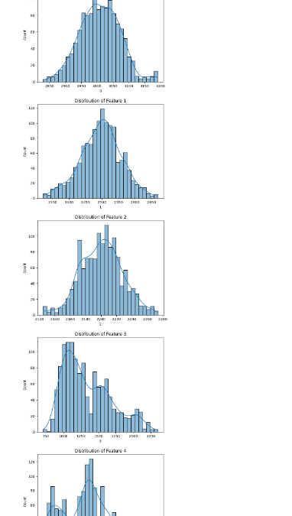
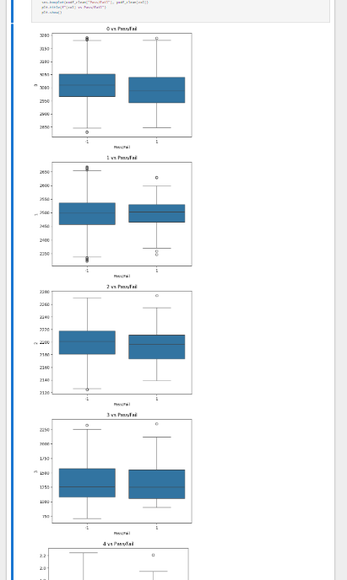
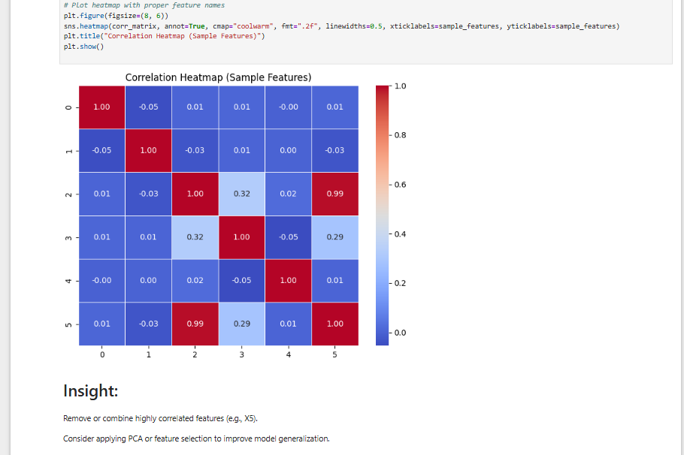

Slide 7
Preprocessing
Feature/target split
Applied SMOTE to balance classes
Used StandardScaler to normalize features
Train-test split: 80-20 (stratified)
: Step 5 - Model: Random Forest
Used GridSearchCV for tuning:
n_estimators, max_depth, min_samples_split
Best model found using cross-validation
Evaluated on test set with classification report
13: Step 5 - Model: SVM
Kernel types: RBF, Linear
Tuned C, gamma, and kernel using GridSearch
Lower performance than RF, more sensitive to outliers
Step 5 - Model: Naive Bayes
GaussianNB used without hyperparameter tuning
Fast and interpretable but less accurate than RF

Slide 8
Model Comparison
Selected Model: Random Forest
Model | Accuracy | Precision | Recall | F1-Score
RandomForest | Best | Best | Best | Best
SVM | Medium | Medium | Low | Medium
Naive Bayes | Low | Low | High | Low

Slide 9
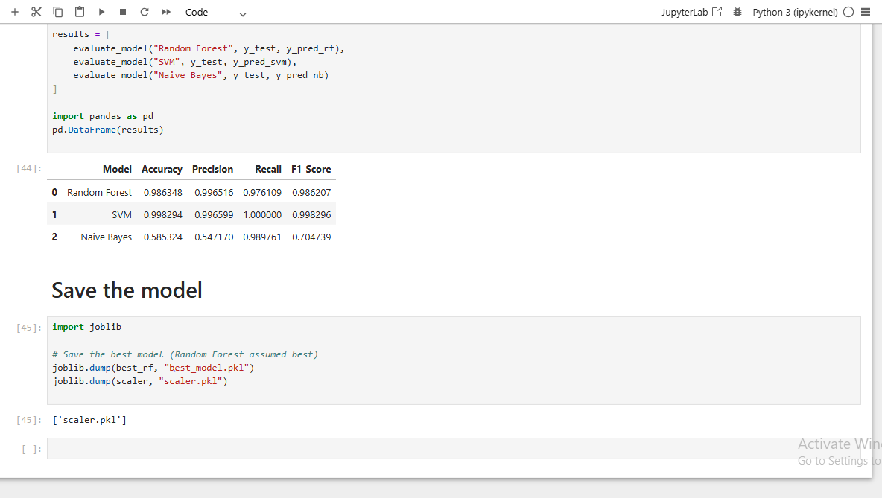
Saving Model
Best model saved using joblib
Also saved the StandardScaler
Ready for deployment/inference

Slide 10
Conclusion & Improvements
Random Forest gave best overall results
SMOTE + Scaling improved model performance
Future scope:
Use PCA or feature selection to reduce dimensions
Try ensemble models (e.g., XGBoost)
Real-time inference and monitoring
Tools Used
Python
Pandas, NumPy
Matplotlib, Seaborn
Scikit-learn

